Slide 1
BMI Prediction Using Machine Learning
Nikhil B Nair
June 28, 2026
BMI Prediction

Slide 2









Agenda
1
Introduction
Objectives
Dataset
Data Preprocessing
Feature Engineering
Model Training
Results
8
Conclusion
9
Future Scope
BMI Prediction

Slide 3
Introduction
What is BMI?
Body Mass Index (BMI) is a numerical measure that relates a person’s weight to their height. It is widely used to assess whether an individual is underweight, normal weight, overweight or obese.
The mathematical formula is
Weight(kg )
BMI =
Height(m)²
Importance of BMI
Health Risk Assessment Fitness Monitoring Obesity Detection Clinical Decision Support
BMI Prediction

Slide 4
Objectives
The objectives of this project are
Study BMI prediction using Machine Learning Explore the dataset
Perform preprocessing Encode categorical variables Calculate BMI values
Train a Linear Regression model Evaluate prediction accuracy Predict BMI for unseen data
1
2
3
4
5
6
7
8
BMI Prediction

Slide 5
Dataset Overview
The dataset consists of approximately 500 observations.
Feature
Description
Gender Height Weight Index
Male/Female
Height in centimeters Weight in kilograms BMI Category
Observation
Dataset contains no missing values.
Height ranges from approximately 140 cm to 199 cm. Weight ranges from approximately 50 kg to 160 kg. BMI values were calculated during preprocessing.
BMI Prediction

Slide 6
Data Preprocessing
Before training the Machine Learning model, the dataset was preprocessed to ensure consistency and improve model performance.
Steps Performed
Checked for missing values using isnull().sum() Verified dataset information using df.info() Encoded the Gender column
Calculated BMI using the standard BMI formula Selected input and target variables
1
2
3
4
5
Result
No missing values were found. Dataset was ready for model training.
BMI Prediction

Slide 7
Feature Engineering
Since the dataset contained only BMI Categories (Index), a new BMI column was calculated.
Input Features Gender Height Weight
Target Variable
BMI
This feature engineering step enabled the Linear Regression model to learn the relationship between physical characteristics and BMI.
BMI Prediction

Slide 8
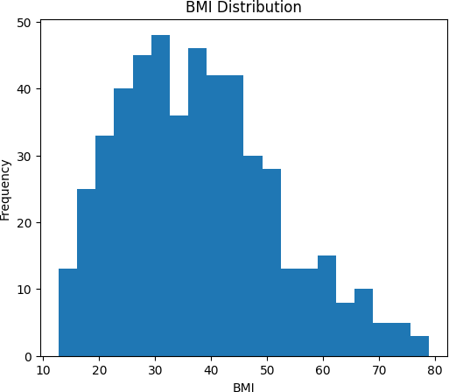
BMI Distribution Analysis
BMI Prediction

Slide 9
Observations
The histogram illustrates the distribution of BMI values in the dataset.
Most BMI values lie between 25 and 45, indicating that a large proportion of individuals belong to the overweight categories.
Very few observations have BMI values below 20 or above 70.
The distribution is positively skewed, with a longer tail towards higher BMI values.
The wide range of BMI values provides sufficient variability for training an effective regression model.
Insight: The dataset contains a diverse range of BMI values, enabling the Linear Regression model to learn meaningful relationships between Height, Weight, and BMI.
BMI Prediction

Slide 10
Model Training
The processed dataset was divided into training and testing datasets.
Training Data : 80% Testing Data : 20%
Algorithm Used
Linear Regression
Linear Regression was selected because BMI is a continuous numerical variable, making regression the most suitable Machine Learning approach.
BMI Prediction

Slide 11
Model Evaluation
The trained model was evaluated using four standard regression metrics.
Metric | Value
Mean Absolute Error (MAE) | 1.887
Mean Squared Error (MSE) | 6.587
Root Mean Squared Error (RMSE) | 2.567
R² Score | 0.971
Interpretation
Average prediction error is only about 1.9 BMI units.
The model explains approximately 97.1% of the variance in BMI values.
BMI Prediction

Slide 12
Results and Insights
Key Observations
Actual and Predicted BMI values closely matched. Low RMSE indicates stable predictions.
Weight contributed more strongly to BMI prediction than Height. Gender had comparatively lower influence on prediction accuracy. The high R² score confirms excellent model performance.
BMI Prediction

Slide 13
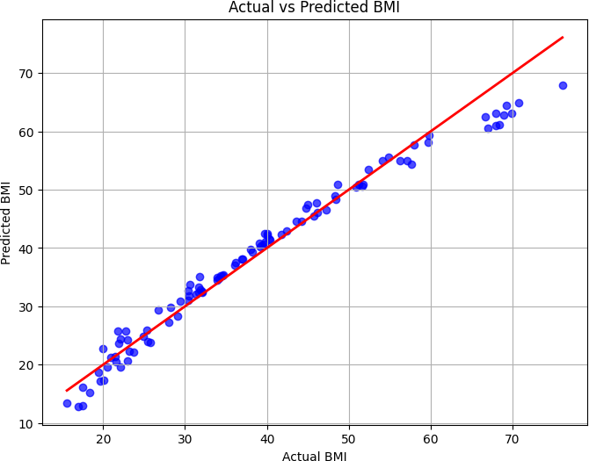
Actual vs Predicted BMI
BMI Prediction

Slide 14
Observation
The scatter plot compares the actual BMI values with the predicted BMI values generated by the Linear Regression model.
The red diagonal line represents the ideal prediction where actual and predicted values are identical.
Most data points lie close to the reference line, indicating high prediction accuracy. The model achieved an R² Score of 0.971, showing that it explains approximately
97.1% of the variance in BMI.
The low values of MAE (1.887) and RMSE (2.567) further confirm the model’s strong predictive performance.
BMI Prediction

Slide 15
Conclusion
Successfully implemented a complete Machine Learning pipeline. Performed data preprocessing and feature engineering.
Calculated BMI using the standard BMI formula. Trained a Linear Regression model.
Achieved excellent prediction performance.
The project demonstrates that a Machine Learning model can accurately estimate BMI using Gender, Height and Weight.
BMI Prediction

Slide 16
Future Scope
Future improvements include
Incorporating Age as an additional feature.
Including lifestyle factors such as diet and physical activity.
Comparing Linear Regression with Decision Tree and Random Forest Regression. Integrating the system into healthcare and fitness applications.
BMI Prediction

Slide 17
Thank You
BMI Prediction

